Slide 1
Network Hardware Resource Management System
Aaditya Sharma
Aryan Dubey
Shreyansh Verma

Slide 2
Table of contents
01
03
02
04
Overview
Design
Requirements
Plan and Progress
Functional Requirements
Non-functional Requirements

Slide 3
01
Overview

Slide 4
Introduction
The Network Hardware Resource Management System is a web-based application designed to efficiently manage hardware resources within a network environment. It allows users to add new hardware resources, remove existing ones, monitor resource usage, and manage Docker containers.

Slide 5
02
Requirements

Slide 6
Functional Requirements
List Hardware Resources
View Live Resource Usage
Add New Hardware Resources
Remove Existing Hardware Resources
View User/Group-Based Resources
Manage Docker Containers

Slide 7
Non-functional Requirements
Usability Requirements
Performance Requirements
Security Requirements
Responsive Design
Minimal Steps
Cross-Browser Compatibility
Response Time
Scalability
Authentication
Data Encryption

Slide 8
03
Design

Slide 9
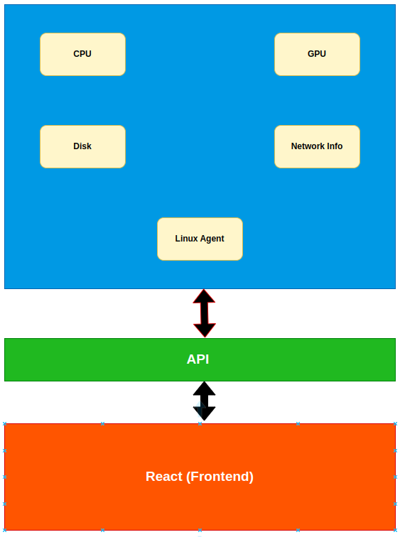

Slide 10
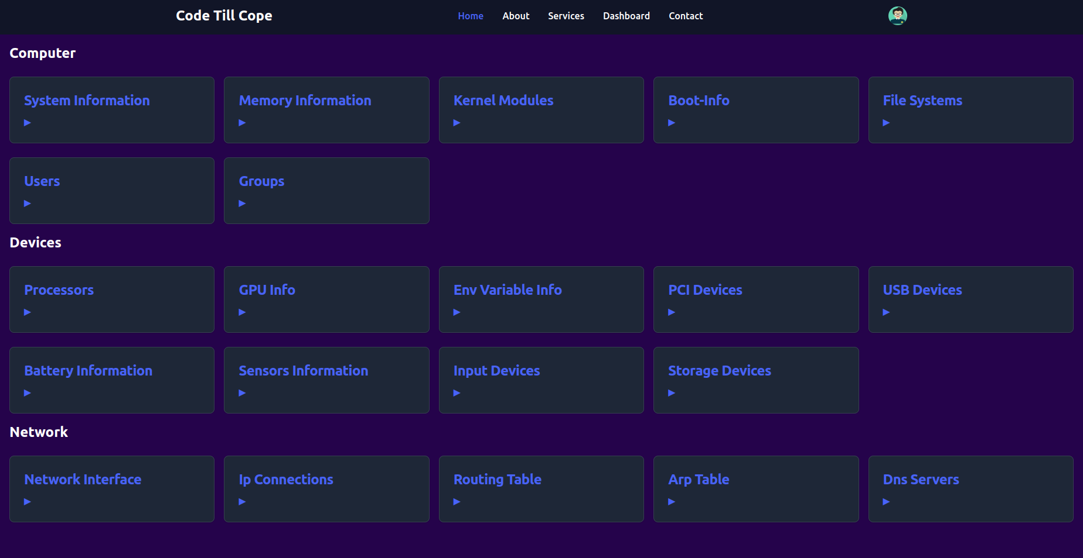

Slide 11
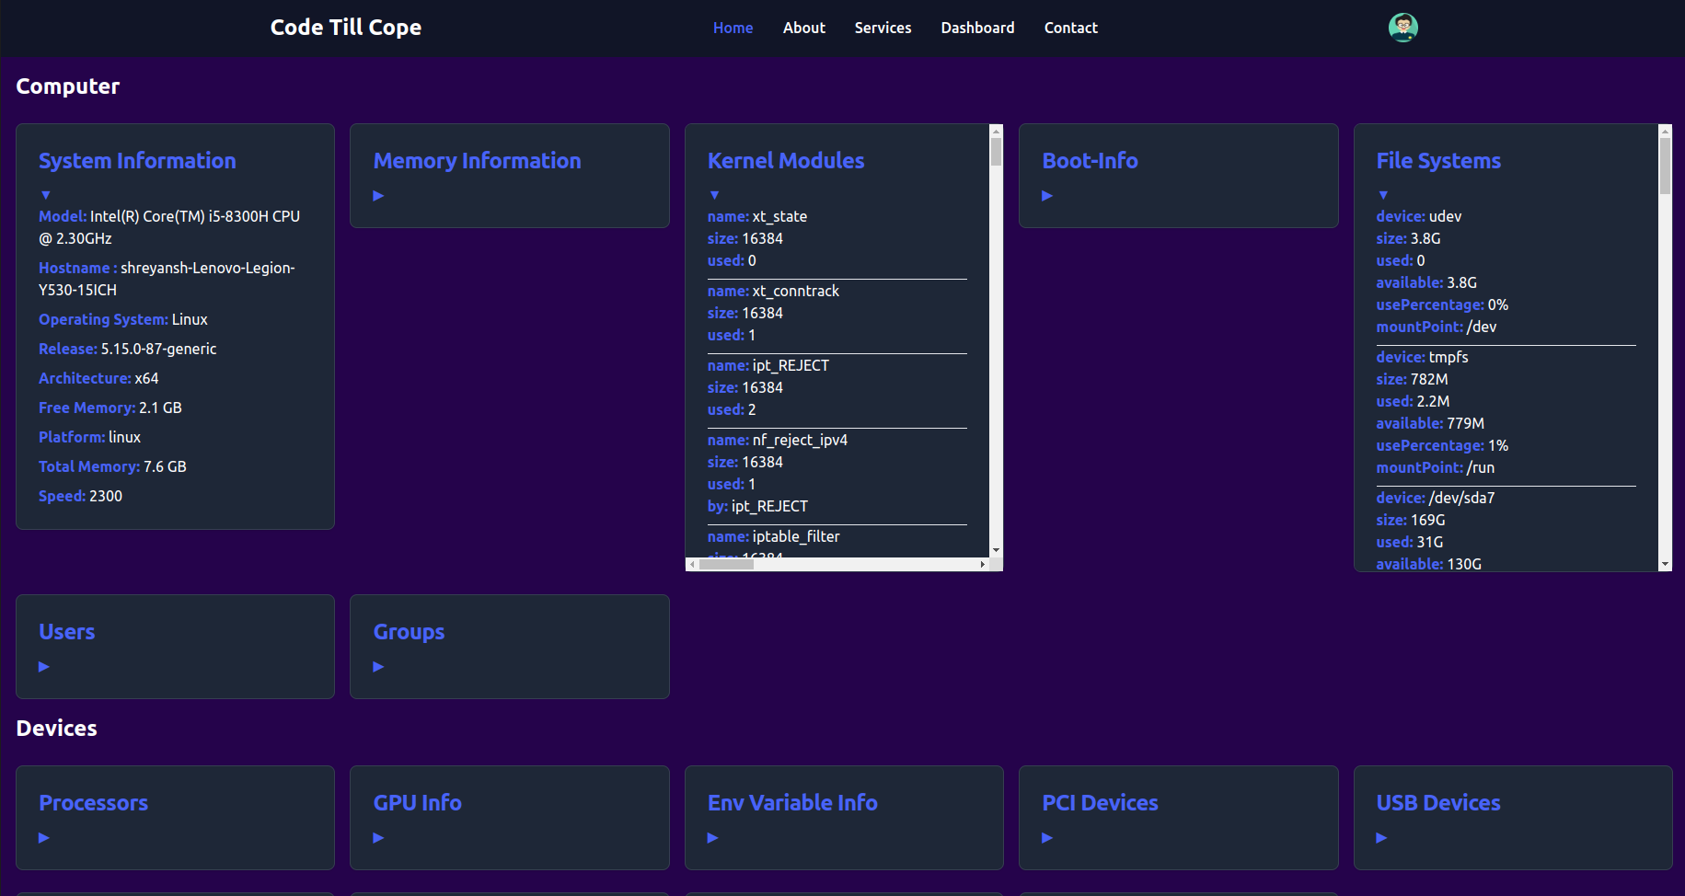

Slide 12
04
Plan & Progress

Slide 13
Project Progress
01 | Phase-1 | Web Interface Listing Down All hardware Resources | √
02 | Phase-2 | Functionality that will enable the admin to monitor the usage of different resources. This will enable us to figure out which of the resources are being overused or underused | Ongoing
03 | Phase-3 | Creation of API to allocate/deallocate resources | To be started

Slide 14
Thank You

